Slide 1

Azure Synapse Link for Azure Cosmos DB
L400 deck

Slide 2
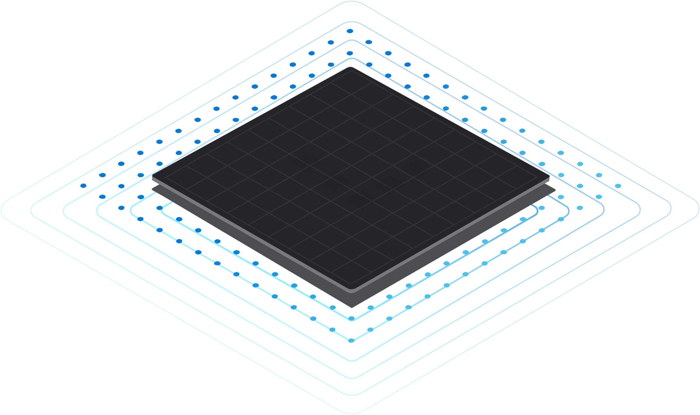


Azure Synapse Link for Azure Cosmos DB
HTAP = Breaking down the barrier between OLTP & OLAP
Near real-time data analytics
No performance impact on transactional workloads
Costs reduction for BI and Analytics workloads
Simplified management
1
Azure Synapse
Azure
Cosmos DB

Slide 3
Key Benefits | Resume
Data available for analytics in ~2 mins at no RUs cost, with no storage and ETL management
Cost reduction with RUs, queries happen on Synapse Analytics reading from analytical store
Cost reduction with data tiering
Affordable and queryable cold store for a fraction of the cost. Analytical store compresses the data up to 90% and has 10% of the $/GB price.
Cost reduction with less RUs since there is a minimum RUs per GB in transactional store
1-click integration with Power BI and Synapse Analytics
Full T-SQL language: joins, stored procedures, aggregations, natural integration with BI Tools
Allows customers to model their data with focus on data ingestion

Slide 4

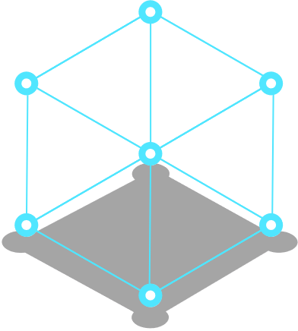






How it works? Azure Synapse Link under the hood

Slide 5






Azure Synapse Link for Cosmos DB
Transactional Store
Row store optimized for transactional operations
Analytical Store
Column store optimized for analytical queries
Container
Machine learning
Operational
Data
Cloud-Native HTAP
Big data analytics
Auto-Sync
Azure Synapse Link
SQL
serverless
BI Dashboards
Azure Cosmos DB
Azure Synapse Analytics
Generate near real-time insights on your operational data

Slide 6
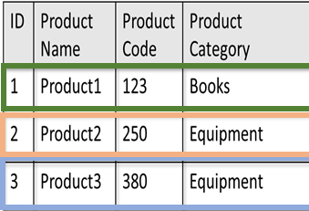
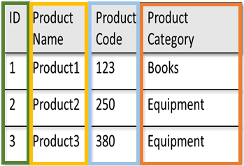
Analytical store | Enabling No-ETL HTAP
Container
“Auto-Sync”: Your transactional data is automatically synced to analytical store within 2 mins
Self-managed compute, throughput, and storage, without any downtime
No performance or costs impact on your transactional workloads
Automatic schema inference
Native integration with Synapse to analyze the data directly with SQL & Spark runtimes
Cosmos DB data is available for analytics in any global region where the Cosmos DB account is replicated
Transactional Store [Row store]
Analytical Store [Column store]
Auto-Sync
Disk-Logical Representation
Disk-Logical Representation

Slide 7
Analytical store settings
First step is to turn on Synapse Link in your Azure Cosmos DB Database Account
Second step is to turn on Synapse Link in your containers
By setting analytical TTL with CLI, PowerShell, or SDKs
In the portal
If “analytical store” is on:
Cosmos DB starts replicating the transactional data [“Auto-Sync”]
Applies to all regions where the Cosmos DB account is replicated
Supported for SQL API and Azure Cosmos DB API for Mongo DB

Slide 8
Analytical store settings
Now customers can turn Synapse Link off at container level
CLI or PowerShell only
By setting analytical TTL to 0
This action can’t be undone
Once it is turned off, that container can’t have it turned on again
Customers can’t turn Synapse Link off at account level
No billing impact
Currently it blocks the usage of continuous backup and partition merge

Slide 9
Analytical Time-To-Live (TTL)
You can choose how long data should be retained in your analytical store (like transactional TTL for transactional store)
Analytical TTL set on a container:
Value | Analytical data retention | When to use?
0 or null | No data replicated from transactional store | Use the container only for transactional workloads Default, when analytical store is turned off
-1 | Infinite retention of analytical data in your container | Retain all historical data for analysis
‘n’ | Items will expire from the analytical store "n" seconds after their last modified time in the transactional store. | Expire items in analytical store independent of transactional data Cost-effective for storage

Slide 10
Seamless data tiering using Analytical & Transactional TTL
You can specify analytical TTL and transactional TTL on a container independently
Value | When to use?
Analytical TTL > Transactional TTL | Retain your data longer in analytical store
Analytical TTL same as Transactional TTL | Mirror data in transactional store
Analytical TTL < Transactional TTL | Expire items in analytical store earlier than in transactional store

Slide 11
Schema Inference
The following constraints are applicable on the operational data in Azure Cosmos BDB when you enable analytics store to automatically infer and represent the schema correctly:
You can have a maximum of 200 properties at any nesting level in the schema and a maximum nesting depth of 5
An item with 201 properties at the top level does not satisfy this constraint and hence it will not be represented in the analytical store
An item with more than five nesting levels in the schema does not satisfy this constraint and hence it will not be represent3ed in the analytical store. For example, the following item does not satisfy the requirement:
{“level1”: {“level2”: {“level3”: {level4”: {“level5”: {“too many”:12}}}}}}
Property names should be unique when comparing case insensitivity. For example, the following items do not satisfy this constraint and hence will not be represented in the analytical store: {“Name”: “fred”} {“name”: “john”} – “Name” and “name” are the same when compared in a case insensitive manner.

Slide 12
Schema Inference
Well Defined Schema is the default option for SQL API accounts
The First document of the container defines the schema
Documents with different properties won’t be synced to analytical store
Full Fidelity Schema is the default option for Mongo DB API accounts
Analytical store will have one column for each datatype of each property
Example:
Select price.float64
From Orders
Where status.string = ‘1’ or status.int32 = 1

Slide 13
Schema Inference
Now customers can enable Full Fidelity Schema for SQL API accounts
Using CLI or PowerShell. The same command has to enable Synapse Link at account level and define that the schema inference option is Full Fidelity
If the portal is used to enable Synapse Link in a SQL API account, it will be Well Defined Schema
Account level property, impacts all containers in the account
Can’t be changed later

Slide 14
Backup
Analytical store data isn’t backup or restored
But it is fully protected against physical failure
Single region Cosmos DB database accounts allocate analytical store in Locally Redundant Storage (LRS) Azure Storage accounts.
If any geo-region replication of the Cosmos DB database account is configured, analytical store is allocated in Zone-Redundant Storage (ZRS) Azure storage accounts.
Analytical store will exist and be available as long as the container exists

Slide 15
Backup – Protection against logical errors
Periodic backups mode
This is the traditional Cosmos DB backup mode
Customers can use periodic backup and Synapse Link in the same database account
Containers are restored:
Without analytical store (analytical TTL = NULL)
In a new database account
After restore, customers can rebuild analytical store by setting analytical TTL to -1 or any positive integer

Slide 16
Backup | Protection against logical errors
Periodic backups mode
If the original container has analytical TTL > transactional TTL
This means that some data only exists in analytical store
This data isn’t restored
Customers can:
Keep the old container to keep the old analytical store and start to query old and new analytical stores (Union).
For costs optimization, the old container may have transactional TTL = 0
Export this data to any other storage and used it as necessary
Re-ingest this data into transactional store (not supported, customers need to do it by themselves

Slide 17
Backup | Protection against logical errors
Continuous backups mode
This is the new Cosmos DB backup mode
Currently customers can enable Synapse Link in database accounts that have continuous backup by opening a support ticket
Currently customers can’t enable continuous backup in accounts that have Synapse Link enabled
Customers can create new accounts with Synapse Link and continuous backup enabled, using CLI or PowerShell

Slide 18
Pricing
Order of Magnitude: Doesn’t consider discounts, enterprise agreements, regional costs, partners pricing, etc.
Item | Analytical Store | Transactional Store
1 GB of Data | $0.02/month | $0.25/month
Read / Write | Writes: $0.05 / 10K operations Reads: $0.005/10K operations | RUs
Synapse Analytics Runtime | Serverless Pool = $5.00/TB Spark Pool = $0.167 / vCore-hour | RUs

Slide 19
Pricing
Key facts about SQL Serverless pricing ($5.00/TB)
Fact | Details | Example
Compression | Analytical store compresses transactional data ~5x | 5 TB OLTP ~ 1 TB OLAP
Indexing | Metadata indexing avoids full scans. | Only the necessary data is scanned and billed.
Filtering | When using UTF8 collations, we have filtering push down | Only the necessary data is scanned and billed.

Slide 20
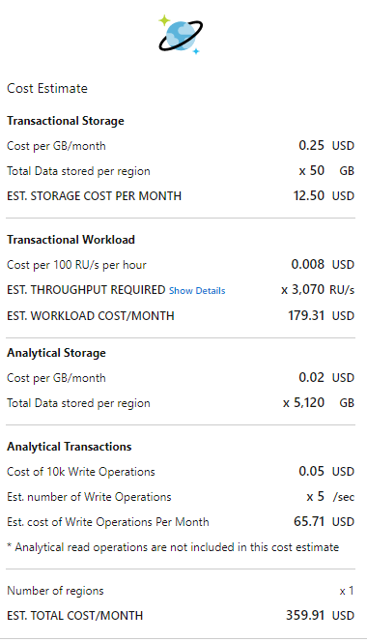
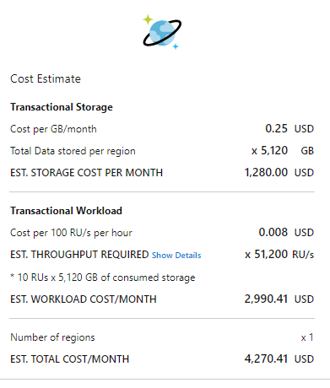
Pricing Comparison
OLAP: Data = 5 TB, reads = unlimited
OLTP: Data = 100 GB, reads = 100/s
OLTP: Data = 5 TB, reads = 1000/s

Slide 21



Cosmos DB Synapse Link | TCO comparison
Cosmos DB Transactional Storage size (GB) | 1935
Total number of Docs | 335,811,130
Cosmos DB Max Autoscale RU/s | 1M
Ingestion duration (Hours) | 10
Inserts/Updates with Cosmos DB HTAP
(Synapse Link)
Inserts/Updates using CDC directly on OLTP store
User Applications
Azure Cosmos DB
Azure Synapse Link
Azure Synapse Analytics
User Applications
Azure Cosmos DB
Raw data (Bronze)
Deduped data (Silver)
Provisioned RU/s | 1000000
Provisioned RU/s | 1250000
Cost of Cosmos DB RU/s for 9.5 hours (ingestion) | $800.000
Cost of Cosmos DB Transactional Storage | $483.63
Cost of Cosmos DB Analytical Storage | $28.82
Cost of Cosmos DB Analytical Store Write Operations | $26.85
Cost of Analytical Store Partitioning execution (take out for base case) | $23.09
Total | $1,339.29
Cost of Cosmos DB RU/s for 9.5 hours (ingestion + change feed) | $1,000.000
Cost of Cosmos DB Transactional Storage | $483.63
Cost of Spark compute to Stream to Bronze Delta Lake | $230.94
Cost of Spark compute to Stream to Silver Delta Lake | $1,847.52
Cost of Delta Lake storage | $21.23
Total | $3,583.33
63% cost reduction with Synapse Link

Slide 22
Pricing
https://azure.microsoft.com/pricing/details/cosmos-db/
https://azure.microsoft.com/pricing/details/synapse-analytics/
https://cosmos.azure.com/capacitycalculator/

